Slide 1
Question 123.16.1
What is the microscopic mechanism for energy transfer between two objects in thermal contact?
collisions
Heat moving
Transfer of particles
Radiation

Slide 2
Question 123.16.0.1
Can time go backwards?
Of course, you just make the Enterprise go really fast
No
Yes, but you need to travel in space as well

Slide 3
Question 123.16.0.2
Why does time only go one direction?
Because we are not The Flash and can’t run fast enough
Because the second law of thermodynamics says so
We don’t know

Slide 4
Question 123.16.1
Does disorder always increase in thermodynamic processes?
Yes
No
Maybe (be prepared to explain)

Slide 5
N₁
N₂
T₁
T₂

Slide 9
Question 123.16.2
In thermodynamics, we have several state variables. Combined with the Ideal Gas Law we have ΔE_{in}t, P, V, n, and T. There is one more we are studying, it is
R
ΔS
C_{v}
C_{p}

Slide 10
Probabilities:
Two boxes:
One particle on left: ½
Two particles on left: ¼
50 particles on left: 1/1125899906842624
Two boxes, 100 particles, 50 slowest on one side, 50 fastest on the other
1/1267650600228229401496703205376

Slide 11
Adiabatic Free Expansion Again
V_{i}
Vacuum

Slide 12
Entropy, Molecule Example Extended
Consider 100 molecules in the container
The probability of separating 50 fast molecules on one side and 50 slow molecules on the other side is (½)¹⁰⁰
If we have one mole of gas, this is found to be extremely improbable

Slide 13
Entropy and Heat
The original formulation of entropy dealt with the transfer of energy by heat in a reversible process
Let dQ_{r} be the amount of energy transferred by heat when a system follows a reversible path
The change in entropy, ΔS is

Slide 14
Entropy and Heat, cont
The change in entropy depends only on the endpoints and is independent of the path followed
The entropy change for an irreversible process can be determined by calculating the change in entropy for a reversible process that connects the same initial and final points

Slide 15
More About Change in Entropy
dQ_{r} is measured along a reversible path, even if the system may have followed an irreversible path
The meaningful quantity is the change in entropy and not the entropy itself
For a finite process,

Slide 16
Change in Entropy, cont
The change in entropy of a system going from one state to another has the same value for all paths connecting the two states
The finite change in entropy depends only on the properties of the initial and final equilibrium states

Slide 17
ΔS for a Reversible Cycle
ΔS = 0 for any reversible cycle
In general,
This integral symbol indicates the integral is over a closed path

Slide 18
ΔS for a Quasi-Static, Reversible Process
Assume an ideal gas undergoes a quasi-static, reversible process
Its initial state has T_{i} and V_{i}
Its final state has T_{f} and V_{f}
The change in entropy is
This demonstrates that ΔS depends on only the initial and final states and not the path between the states

Slide 19
Entropy Changes in Irreversible Processes
To calculate the change in entropy in a real system, remember that entropy depends only on the state of the system
Do not use Q, the actual energy transfer in the process
Distinguish this from Q_{r} , the amount of energy that would have been transferred by heat along a reversible path
Q_{r} is the correct value to use for ΔS

Slide 20
Entropy Changes in Irreversible Processes, cont
In general, the total entropy and therefore the total disorder always increases in an irreversible process
The total entropy of an isolated system undergoes a change that cannot decrease
This is another statement of the second law of thermodynamics

Slide 21
Entropy Changes in Irreversible Processes, final
If the process is irreversible, then the total entropy of an isolated system always increases
In a reversible process, the total entropy of an isolated system remains constant
The change in entropy of the Universe must be greater than zero for an irreversible process and equal to zero for a reversible process

Slide 22
Heat Death of the Universe
Ultimately, the entropy of the Universe should reach a maximum value
At this value, the Universe will be in a state of uniform temperature and density
All physical, chemical, and biological processes will cease
The state of perfect disorder implies that no energy is available for doing work
This state is called the heat death of the Universe

Slide 23
ΔS in Thermal Conduction
The cold reservoir absorbs Q and its entropy changes by Q/T_{c}
At the same time, the hot reservoir loses Q and its entropy changes by -Q/T_{h}
Since T_{h} > T_{c} , the increase in entropy in the cold reservoir is greater than the decrease in entropy in the hot reservoir
Therefore, ΔS_{U} > 0
For the system and the Universe

Slide 24
ΔS in a Free Expansion
Consider an adiabatic free expansion
Q = 0 but cannot be used since that is for an irreversible process

Slide 25
ΔS in Free Expansion, cont
For an isothermal process, this becomes
Since V_{f} > V_{i} , ΔS is positive
This indicates that both the entropy and the disorder of the gas increase as a result of the irreversible adiabatic expansion

Slide 26
ΔS in Calorimetric Processes
The process is irreversible because the system goes through a series of non-equilibrium states
Assuming the specific heats remain constant and no mixing takes place:
If mixing takes place, this result applies only to identical substances
ΔS will be positive and the entropy of the Universe increases

Slide 27
Question 22.4
Which two quantities are “state variables” meaning they are path independent?
The change in internal energy and change in entropy
The change in internal energy and work
The change in internal energy and heat
Heat and work
The change in internal energy and mean free path

Slide 28
Question 20.8
By observing a system we find that
ΔE_{int} = 0
What might be the reason for this?
It is isolated
It is cyclic
It is isobaric
Can’t tell

Slide 30
An Opinion on the Second Law of Thermodynamics and Mormon Thought

Slide 31
Warning
This is not an official statement of doctrine
This is an answer to a question that many scientists must face from colleagues who will try to attack their faith using the principals of thermodynamics
Official statements by the General Authorities supersede any opinions expressed here

Slide 32
First Law: Conservation of Energy (and Mass)
And there stood one among them that was like unto God, and he said unto those who were with him: We will go down, for there is space there, and we will take of these materials, and we will make an earth whereon these may dwell; (Abraham 3:24 )
You ask the learned doctors why the say the world was made out of nothing; and they will answer, ‘Doesn’t the Bible say He created the world?’ And they infer, from the word create, that it must have been made out of nothing. Now, the word create came from the word baurau which does not mean create out of nothing; it means to organize; the same as a man would organize materials and build a ship.
Joseph Smith, King Follett Discourse
The idea of the first law of thermodynamics seems in harmony with LDS thought

Slide 33
Second Law
Jacob Describes the conditions called for by the second law
Wherefore, the first judgment which came upon man must needs have remained to an endless duration. And if so, this flesh must have laid down to rot and to crumble to its mother earth, to rise no more. (2 Nephi 9:7)
And our spirits must have become like unto [Satain], and we become devils, angels to a devil, to be shut out from the presence of our God, and to remain with the father of lies, in misery, like unto himself. (2 Nephi 9:9)
We also seem to accept the concept of the second law as well
--This will be a surprise to our non-Mormon friends

Slide 34
Does Something Counter the Second Law (a Third Law of Thermodynamics)?
Jacob describes another force not recognized by current scientific theory that counteracts this tendency to decay
Wherefore, it must needs be an infinite atonement—save it should be an infinite atonement this corruption could not put on incorruption. Wherefore, the first judgment which came upon man must needs have remained to an endless duration. And if so, this flesh must have laid down to rot and to crumble to its mother earth, to rise no more. (2 Nephi 9:7-8)
O how great the goodness of our God, who prepareth a way for our escape from the grasp of this awful monster; yea, that monster, death and hell, which I call the death of the body, and also the death of the spirit. (2 Nephi 9:10)
Atonement means to bring together. This is an apt description of a process or law that would counter or balance the second law
(Nibley, The meaning of the temple, reprinted in the Collected Works of Hugh Nibley: volume 12, Deseret Book, Salt Lake City, UT, 1992)
Since the atonement can only be accessed through Christ, it is not likely to be discovered in a laboratory, but is a very real, physical, process. (see for example Luke 24:39)

Slide 35
Entropy, Marble Example
Suppose you have a bag with 50 red marbles and 50 green marbles
You draw a marble, record its color, return it to the bag, and draw another
Continue until four marbles have been drawn
What are possible macrostates and what are their probabilities?

Slide 36
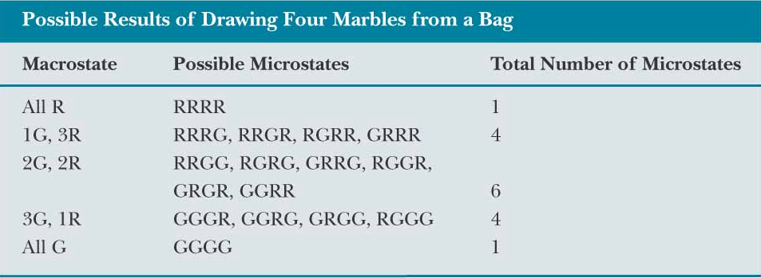
Entropy, Marble Example, Results
The most ordered are the least likely
The most disorder is the most likely

Slide 37
Summary
Two forms of entropy equations
Microscopic
Cyclic Reversible Process
Problems to now try 9-13

